Slide 1
Life Cycle of an SGX Enclave

Slide 2
Contents
SGX Physical Memory Organization
The Memory Layout of an SGX Enclave
The Life Cycle of an SGX Enclave
The Life Cycle of an SGX Thread
EPC Page Eviction

Slide 3
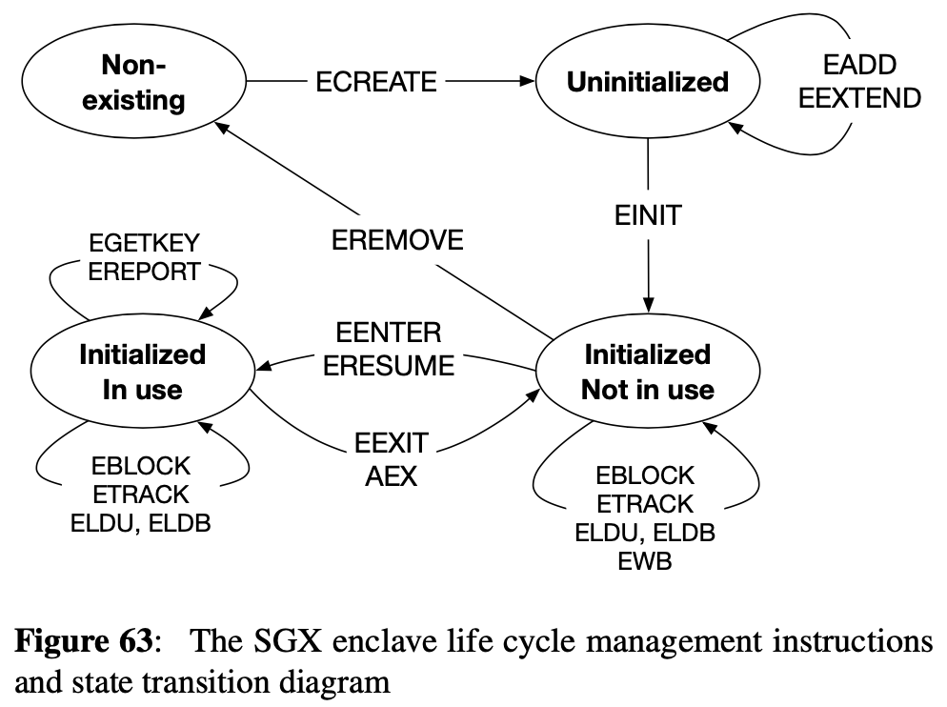
Overview
instructions that transition between different life cycle states
can only be executed by the system software.

Slide 4
Creation / ECREATE
Enclave is born when the system software issues the ECREATE instruction
turns a free EPC page into the SECS for the new enclave.
ECREATE initializes the newly created SECS using the information in a non-EPC page owned by the system software.
Defined in SDM / BASEADDR & SIZE
ECREATE validates the information used to initialize the SECS, and results in a page fault or general protection fault if the information is not valid.
ECREATE initializes the enclave’s INIT attribute to the false value.
Enclave’s code cannot be executed until the INIT attribute is set to true
Marks the newly created SECS as uninitialized.
Notes:
For example, if the SIZE field is not a power of two, ECREATE results in #GP.
A General Protection Fault (GPF) is a Windows system error message. A GPF is not an error within an application, but an error in the Windows operating system itself.

Slide 5
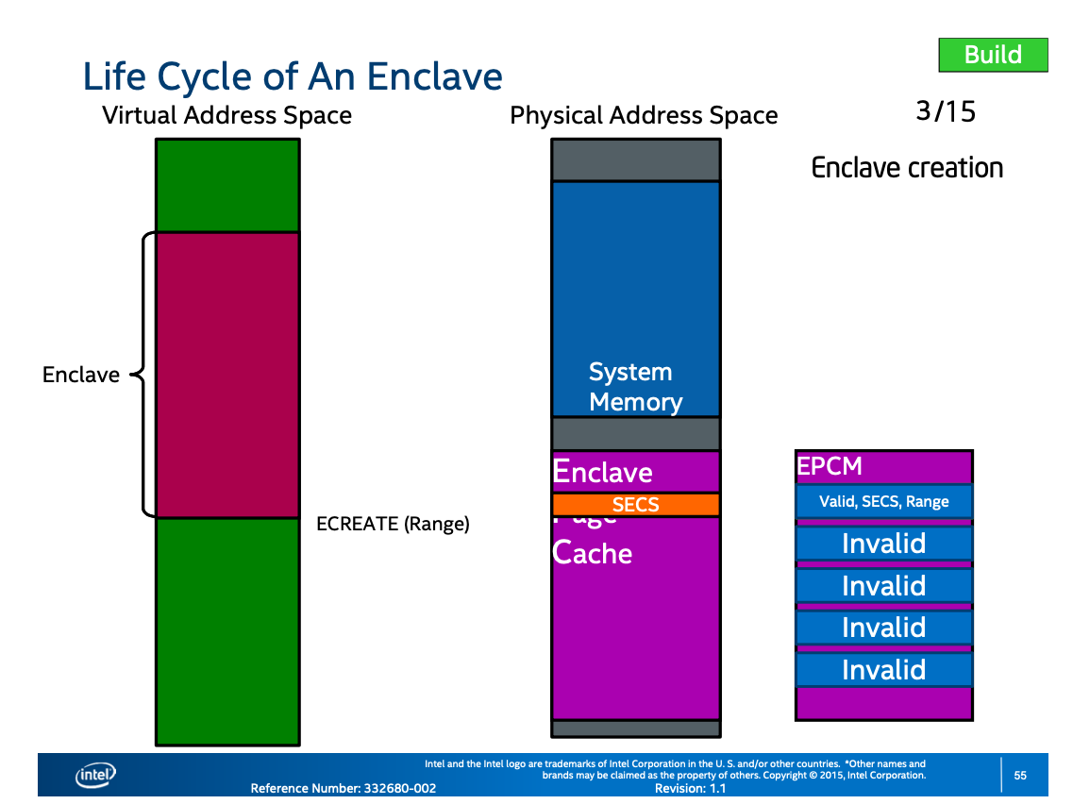
Creation / ECREATE
Notes:
ECREATE
▪ Creates a unique instance of an enclave, establishes the linear address range, and serves as the enclave’s root of trust
Enclave mode of operation // Processor features that enclave supports // Debug is allowed or not
▪ This information stored within an Secure Enclaves Control Structure (SECS) generated by ECREATE.

Slide 6
Loading / EADD, EEXTEND
Load the initial code and data into the enclave.
EADD is used to create both TCS pages and regular pages.
EADD reads its input data from a Page Information (PAGEINFO) structure.
PAGEINFO
LINADDR : virtual address of the EPC page that will be allocated
SRCPGE : virtual address of the non-EPC page whose contents will be copied into the newly allocated EPC page
SECS : virtual address that resolves to the SECS of the enclave that will own the page
SECINFO : values for some of the fields of the EPCM entry associated with the newly allocated EPC page
Notes:
Add Regular (REG) or Thread Control Structure (TCS) pages into the enclave •
System software responsible for selecting free EPC page, type, and attributes, content of the page and the enclave to which the page added to.

Slide 7
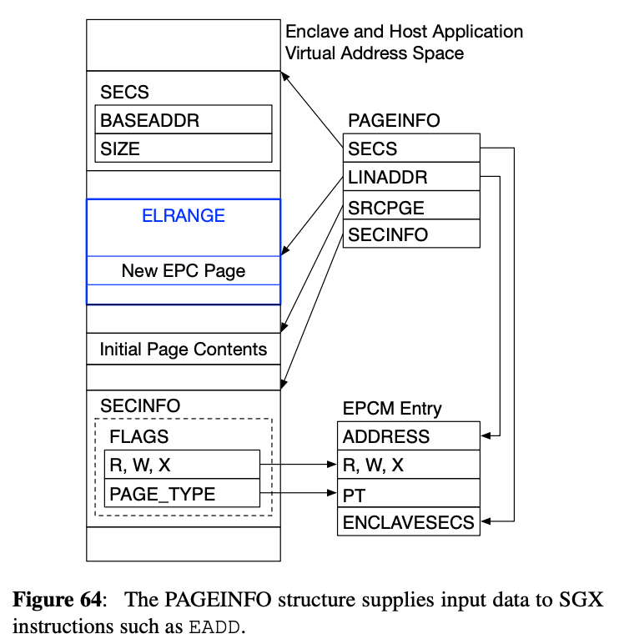
Loading / EADD, EEXTEND
Notes:
Furthermore, attempting to EADD an EPC page that is already allocated (the VALID field in its EPCM entry is 1) results in a #PF
. EADD also ensures that the page’s virtual address falls within the enclave’s ELRANGE, and that all the reserved fields in SECINFO are set to zero.

Slide 8
Loading / EADD, EEXTEND
SECINFO field in the PAGEINFO structure is actually a virtual memory address, and points to a Security Information (SECINFO) structure
SECINFO structure contains the newly allocated EPC page’s access permissions & EPCM page type.
PAGEINFO and the SECINFO structures are prepared by the system software that invokes the EADD instruction.
contained in non-EPC pages.
EADD validates its inputs before modifying the newly allocated EPC page or its EPCM entry.
Notes:
Most importantly, attempting to EADD a page to an enclave whose SECS is in the initialized state will result in a #GP. General protection fault
Furthermore, attempting to EADD an EPC page that is already allocated (the VALID field in its EPCM entry is 1) results in a #PF page fault
. EADD also ensures that the page’s virtual address falls within the enclave’s ELRANGE, and that all the reserved fields in SECINFO are set to zero.

Slide 9
Loading / EADD, EEXTEND
EEXTEND instruction updates the enclave’s measurement used in the software attestation process.
EEXTEND generates a cryptographic hash of the content of the enclave in 256Byte chunks.

Slide 10
Initialization / EINIT
After loading the initial code and data pages into the enclave, the system software must use a Launch Enclave (LE) to obtain an EINIT Token Structure.
marks the enclave’s SECS as initialized.
LE is a privileged enclave provided by Intel.
prerequisite for the use of enclaves authored by parties other than Intel.
LE is an SGX enclave, so it must be created, loaded and initialized using the processes described in this section.
LE is cryptographically signed with a special Intel key that is hard-coded in the SGX.
EINIT to initialize the LE without checking for a valid EINIT Token Structure.
EINIT completes successfully, it sets the enclave’s INIT attribute to true.
application software can execute the enclave’s code.
INIT is set to true, EADD cannot be invoked on that enclave anymore.
Notes:
Launch Enclave (LE) to obtain an EINIT Token Structure, via an under-documented process that will be described in more detail in § 5.9.1
the system software must load all the pages that make up the enclave’s initial state before executing the EINIT instruction.

Slide 11
Teardown / EREMOVE
System software executes the EREMOVE instruction to deallocate the EPC pages used by the enclave.
EREMOVE marks an EPC page as available by setting the VALID field of the page’s EPCM entry to 0.
EREMOVE makes sure that there is no logical processor executing code inside the enclave that owns the page to be removed.
Enclave is completely destroyed when the EPC page holding its SECS is freed.

